Slide 1
Entrepreneurship in health care
Presented by:
Rawan Alharbi
Initiatives and Innovation Acceleration Officer

Slide 2
Main Outline:
What is Entrepreneurship?
Opportunities for entrepreneurship in healthcare.
Pathways to success and avoid pitfall of failure in entrepreneurship.
Entrepreneurial Challenges.

Slide 3
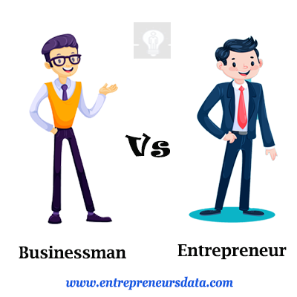
Employee

Slide 4
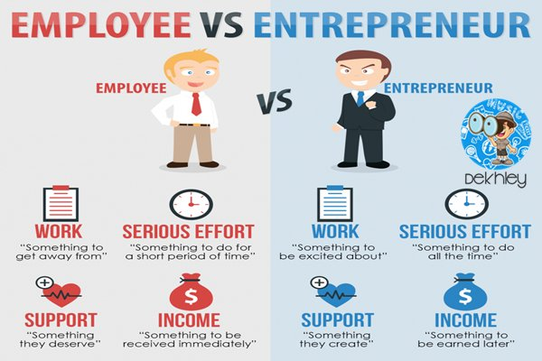

Slide 5
The World of the Entrepreneur
Every year U.S. entrepreneurs launch more than 6.6 million new businesses.
Entrepreneurial spirit - the most significant economic development in recent history.
Globally, nearly one in eight adults is actively engaged in launching a business.

Slide 6
Entrepreneurship-Friendly Nations
GEDI Score, Top Ten Countries | GEDI Score, Bottom Ten Countries
1. United States 83.6 | 128. Benin 13.3
2. Switzerland 80.4 | 129. Burkina Faso 13.2
3. Canada 79.2 | 130. Guinea 12.9
4. United Kingdom 77.8 | 131. Uganda 12.9
5. Australia 75.5 | 132. Sierra Leone 12.3
6. Denmark 74.3 | 133. Malawi 12.2
7. Iceland 74.2 | 134. Bangladesh 11.8
8. Ireland 73.7 | 135. Burundi 11.8
9. Sweden 73.1 | 136. Mauritania 10.9
10. France | 137. Chad 9
45. Saudi Arabia 40.2

Slide 7
What is healthcare entrepreneurship?
Healthcare entrepreneurship is the act of creating a product, process, or service that fills a need or introduces a new development in medicine or healthcare delivery.
Doctors and nurses are often naturally drawn to innovation and entrepreneurship, Why?

Slide 8
Who is the Entrepreneur?
• Entrepreneur:
‒ One who creates a new business in the face of risk and uncertainty for the purpose of achieving profit and growth by identifying opportunities and assembling the necessary resources to capitalize on them.

Slide 9
What is the characteristics Entrepreneur?
CREATIVE
-Entrepreneurs Develop New Ideas, New Concepts And New Ways Of Solving Problems.
-For example, they discover niche markets.
INNOVATIVE
-Innovation introduces change (for example with existing product)
-Innovation is observed when a new idea is converted into a successful product
Notes:
Need a test to discover

Slide 10
What is the characteristics Entrepreneur?
FLEXIBLE AND MULTI-SKILLED
-Entrepreneurs have to carry our different tasks in different areas (human resources, accounts, operations).
-Entrepreneurs can change approaches when necessary.
GOAL ORIENTED
-Goals are targets.
-These targets will be set for themselves and the people they employ.
-The entrepreneur should be clear about the aims of the business and what he hopes to achieve.

Slide 11
What is the characteristics Entrepreneur?
PERSISTENT
-Entrepreneurs should not be easily discouraged.
-They should keep going in the face of difficulty.
-They should rethink ideas when the business seems as if it is failing.
PERSEVERING
-Entrepreneurs keeps trying until they overcome any obstacle.

Slide 12
What is the characteristics Entrepreneur?
TENDENCY TO TAKE CALCULATED RISKS
-All business ventures will entail risks.
-Entrepreneurs will calculate the costs and the benefits.
-They will only pursue a venture if they believe they will earn a profit.
TENDENCY TO TAKE CALCULATED RISKS
-All business ventures will entail risks.
-Entrepreneurs will calculate the costs and the benefits.
-They will only pursue a venture if they believe they will earn a profit.
HARDWORKING
-Successful people always attribute their success to hard work.

Slide 13
What is the characteristics Entrepreneur?
POSITIVE THINKERS
-Entrepreneurs are positive thinkers. They think of success and bright sides.
DECISION MAKERS
-The success of their business depends on their ability to make right decisions.
LEADERSHIP
-Entrepreneurs are leaders by the very nature of their functions.

Slide 14
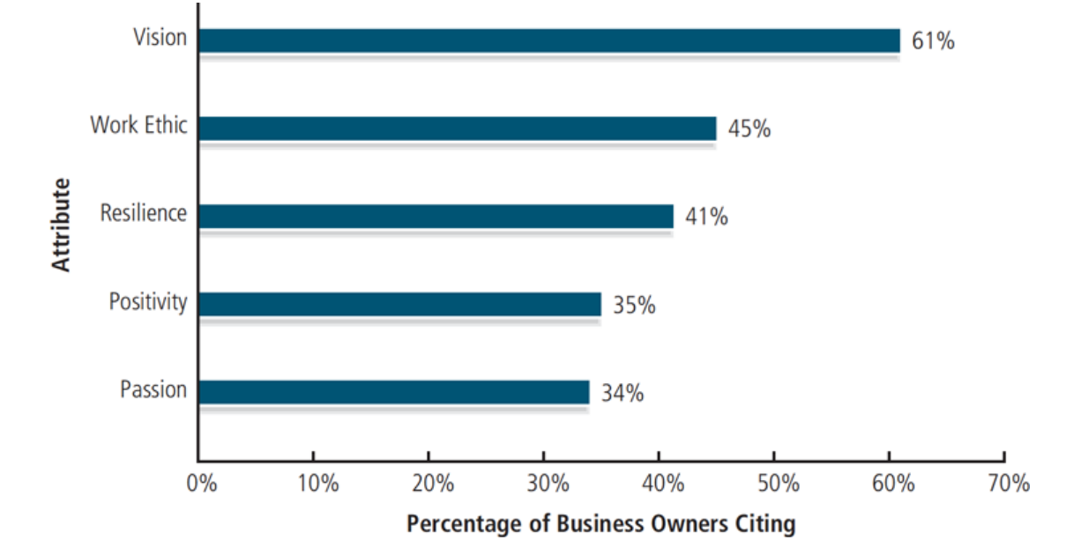
Most important Qualities of an Entrepreneur?

Slide 15
Is it true that any one can be Entrepreneur?
Should we all be an Entrepreneur?

Slide 16
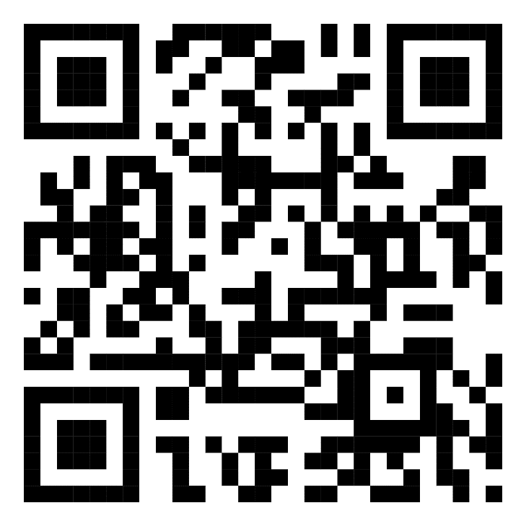
Entrepreneurial potential self-assessment
Notes:
https://www.bdc.ca/en/articles-tools/entrepreneur-toolkit/business-assessments/entrepreneurial-potential-self-assessment

Slide 17
Opportunities for entrepreneurship in healthcare
Urgent Need in the Community
Immunization
communicable diseases
Maternal and infant mortality
Manufacturing medical devices
Pharmaceutical
Clean water and sanitation
Non-communicable diseases
Notes:
Business = Idea = Need in community

Slide 18
Opportunities for entrepreneurship in healthcare
Discovered Need = Business Idea
Invention-based enterprises (IBEs)
Service companies
Notes:
Despite their different business models, both IBEs and service companies have the potential for innovation. Nearly 30 percent of the companies in this study have filed for or received at least one patent, a rate that is comparable for both IBEs and service companies. In addition to operating in these different subsectors within the healthcare sector, companies serve different sets of customers. The businesses and models face different challenges depending on whether they are serving individuals as business to consumer (B2C) companies, public bodies, institutions, or public healthcare providers as business to government (B2G) companies, or those within the healthcare supply chain as business to business (B2B) operations.
Invention-based enterprises (IBEs) are companies that conduct research and development (R&D) and manufacture at least one component that is a physical product in which the innovation is unique enough to be patentable. IBEs comprise almost half (110 out of 228) of the companies in this study and are developing new products that are tailored to the needs of the health sector for diagnosis, treatment, and facilitating access to healthcare.
Service companies encompass three of USAID’s categories of innovation type: service delivery innovators, digital health innovators, and health finance innovators.24 Service delivery innovators assist in the provision of care to patients and to ancillary operations for providers. Most business process companies correspond to this category, as well as some software companies.

Slide 19
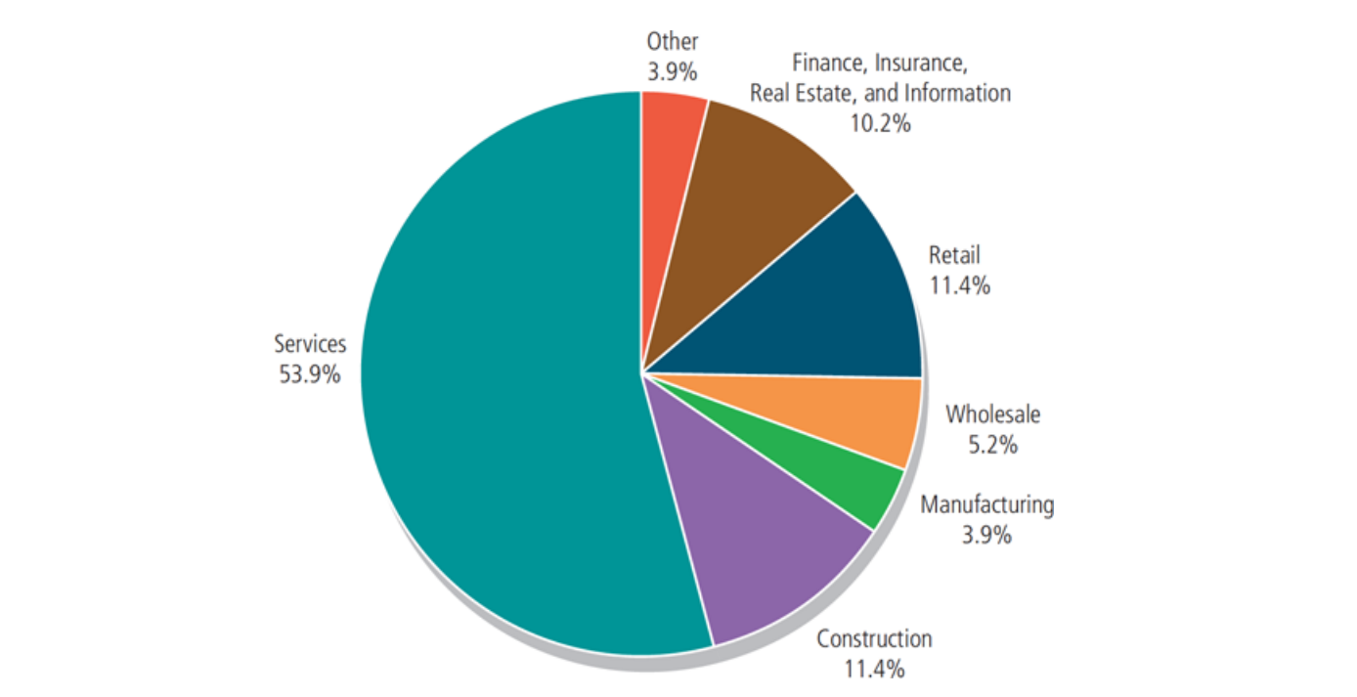
Small Businesses by Industry

Slide 20
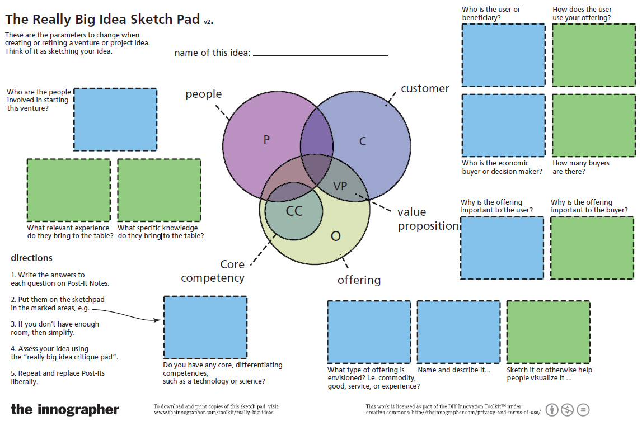
Idea Sketch Pad

Slide 21
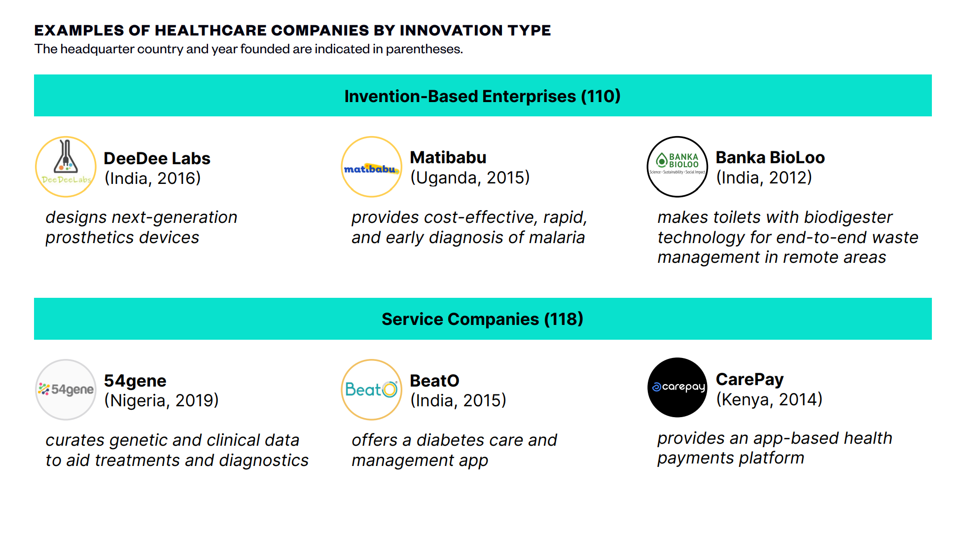
Notes:
India’s DeeDee Labs has built a next-generation, multi-articulating prosthetic hand using muscle electrical signals or biosignals.
To help users manage chronic illnesses; and India’s BeatO, which has developed a diabetes care and management app.

Slide 22
Avoiding the Pitfalls of Failure
Know your business in-depth
Get the best education in your business area you possibly can. Become a serious student of your industry.
Build a viable business model – and test it
Before launching a business, an entrepreneur should define the business model on which he or she plans to build a company and test it.
Notes:
Smart entrepreneurs join industry trade associations and attend trade shows to pick up valuable information and to make key contacts before they open their doors for business.

Slide 24
Avoiding the Pitfalls of Failure
Manage financial resources
No entrepreneur can maintain control over a business unless he or she is able to judge its financial health.
Understand financial statements
To truly understand what is going on in the business, an owner must have at least a basic understanding of accounting and finance.
Notes:
because it produces valuable feedback that entrepreneurs use to improve and refine the product or service and the business model.

Slide 25
Avoiding the Pitfalls of Failure
Develop a solid business plan
The next step is to prepare a business plan. (market analysis, sales strategy, management structure, teams, …)
Title Page and Table of Contents
Executive Summary
Mission and Vision Statement
Description of a Firm’s Product or Service
Business and Industry Profile
Competitor Analysis
Marketing Strategy
Entrepreneurs’ and Managers’ Resumes
Plan of Operation
Pro Forma (Projected) Financial Statements
The Loan or Investment Proposal
Notes:
Smart entrepreneurs join industry trade associations and attend trade shows to pick up valuable information and to make key contacts before they open their doors for business.

Slide 26
Avoiding the Pitfalls of Failure
Build the right team
Businesses started by more one founder are more likely to succeed.
Learn to manage people effectively
Successful business depend on well-trained and motivated employees.
Set your business apart from the competition
Most successful entrepreneurs find a way to differentiate their companies from competitors even if they sell similar products or services.
Maintain a positive attitude
Achieving business success requires an entrepreneur to maintain a positive mental attitude toward business
Notes:
(adequate start-up capital, “Estimate how much capital you need to get the business going and then double that figure”- adequate supply of cash to pay bills and do not count on sales)

Slide 27
Obstacles of Entrepreneurship in Health care
Legal, regulatory, and ethical considerations
Economic incentives
Investment and capital
Risk-averse culture
ENTERING THE MARKET
Notes:
https://dhge.org/about-us/blog/entrepreneurs-in-healthcare-10-examples-of-innovators-in-healthcare-management
1.Drugs and medical devices have a lengthy process of development (bench science) and clinical trials before approval by regulating bodies such as the Food and Drug Administration (FDA). Software applications that manage healthcare data must comply with HIPAA, Medicare, and other agencies’ regulations on patient data and patient privacy. Some of the ethical concerns regarding consumer health gear like smartwatches may also pose an obstacle to wide adoption of a new application.
3. Healthcare innovators who aim to lower healthcare costs are at a disadvantage, because the medical system is still largely run on a fee-for-service basis. Doctors and hospitals are paid per office visit or by procedure. While U.S. healthcare is slowly shifting to a value-based care model, which focuses on preventive measures, the economic incentives still favor fee for service.
4. الرعاية الصحية هي تقليديا تجنب المخاطر. بعد كل شيء ، ينص قسم أبقراط ، "أولاً ، لا ضرر ولا ضرار." يجب أن تتغلب الأفكار التي تتحدى الوضع الراهن على هذا التردد الطبيعي في التغيير.

Slide 28
Books to Read:
Entrepreneurship and Innovation.
Essentials of Entrepreneurship and Small Business Management.
Think like an entrepreneur act like a CEO.
Start with WHY?
Zero to one.
ريادة الأعمال
كيف تبدأ مشروعك الخاص

Slide 29
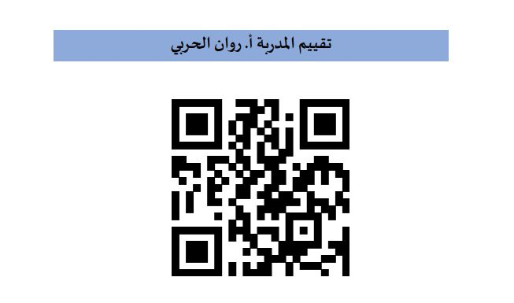

Slide 30
+966536001910
Alharbi.r@kamc.med.sa

